Slide 1

Fundamentals of Software Engineering
LECTURE 1: INTRODUCTION
Farheen Tabassum MS Software Engineering EME,NUST

Slide 2

Name:
Farheen Tabassum
MS – Software Engineering (EME, NUST )
BS – Software Engineering ( F J W U )
FUUAST (Lecturer),
MIU(Lecturer),
NUST ( Research Associate),
Lecturer
.....................
Mon– Wed : 10 am – 11 30 am
Thursday : 10 am– 11 30 am
farheen.tabassum@isb.nu.edu.pk
Qualification:
Prior Experience:
Introduction
Current
Designation
Office: Office Hours:
Email:
2

Slide 3




LMS - Google Classroom
CODE: c65oe4v

Slide 4

Your Introduction!
Your name
How you would rate your communication and critical thinking ability out of 10 How you would rate your coding skills out of 10
Where you see yourself after 4 years?
Your hobby or skills or achievements
What is Software Engineering? Your expectations from course?

Slide 5



▶ Assignments will be submitted online on Google Classroom
▶ All quizzes will be both announced and unannounced
▶ You can be late no more than 10 minutes
(else you are absent)
▶ Bring a pen and a register/copy/paper
▶ Mobile phones shall be OFF/SILENT (RS 2000/- Fine)
▶ Do not wander around in Class
▶ Missed or late assignment will be marked zero
▶ No make up assignments or quizzes
Class Rules

Slide 6
Marks Distribution
Assessment Item | Number | Weight (%)
Assignments | 4 | 8
Quiz | 6 | 12
Project | 1 | 15
Midterm Exam 1 | 1 | 10
Midterm Exam 2 | 1 | 15
Final Exam | 1 | 40

Slide 7
Absolute Grading Scheme:
Total Marks [%] Grade
≥ 90 A+
86-89 A
82-85 A-
78-81 B+
74-77 B
70-73 B-
66-69 C+
62-65 C
58-61 C-
54-57 D+
50-53 D
≤ 49 F
Grading Policy
ABSOLUTE GRADING

Slide 8
Formula for GOOD GRADES
All of you have A+
Just do the following
▶ Maintain Attendance
▶ Positive class attitude and Participation
▶ Perform all class task
▶ Do Quizzes and Assignments YOURSELF
▶ Follow all Rules!
And keep your A+

Slide 9

To familiarize students to the fundamental concepts, techniques, processes, methods and tools of Software Engineering,
To help students to develop basic skills that will enable them to construct software of high quality software that is reliable, and that is reasonably easy to understand, modify and maintain
To foster an understanding of why these skills are important
Goals of the
course

Slide 10
OUT LINE
 | Topics | Description
1 | Introduction to the Course and Software Engineering | Lay out of the course and overall introduction of the discipline of Software Engineering and what we will cover in the course.
2 | Software Processes & Software Process Models | General introduction of processes and software engineer processes. Discussion of different process models and their practical implications. These process models include Waterfall model, evolutionary models and incremental models.
3 | Software Process Models (continued); Analysis modeling | Software process models will be completed in the first lecture of this week. Analysis phase of software engineering will be introduced.
4 | Scenario based modeling | Analysis modeling approaches (Object oriented analysis; Flow oriented analysis).Topics will include requirement gathering using use case diagrams, Activity diagrams, Swim lane diagrams.

Slide 11
OUT LINE
5 | Flow oriented modeling | Data flow diagrams, Control flow diagrams
6 | Behavioral modeling | State diagrams, Sequence diagrams
7 | Class Diagrams | How to create initial domain model and how to develop conceptual class diagram. Usefulness of domain model.
8 | Software Design | General Introduction of Object Oriented Design techniques and methods
9 | Software Architecture | Discussion of need of explicitly defining software architecture and its benefits. What are important determinant of selection of certain architecture or architecture style. Cost and benefit analysis of well know architectural style

Slide 12
OUT LINE
10 | Software Testing | What is software testing process, what methods, tools and techniques are use to verify and validate the software. How software testing process is distributed over entire life cycle of software development.
12 | Software Maintenance | What happen between software is deployed till the time it is retired. How software evolution occurs and how it is managed.
13 | Software Quality | What is software quality, how can we ensure that software we develop is of acceptable quality. Software quality assurances imperatives.
14 | Software Business and Ethics | Business of software is fast become a major GNP producer. Many rules and regulation are there to guide software industry. How business and regulation software engineering practices. (Special Reading)

Slide 13
▶ Software Engineering, Ninth Edition, 2010.
Sommerville, Ian Addison Wesley
Reference Material
Course Books
▶ SE and Testing, b. B. Agarwal s. P. Tayal m.
Gupta, Jones and Bartlett Publishers.
▶ Software Engineering: A Practitioner’s Approach, Pressman, R.S. & Maxim B., 8th Edition (2015), McGraw-Hill.

Slide 14
Motivation

Slide 15
Software can have huge impact in any aspect of our society

Slide 16
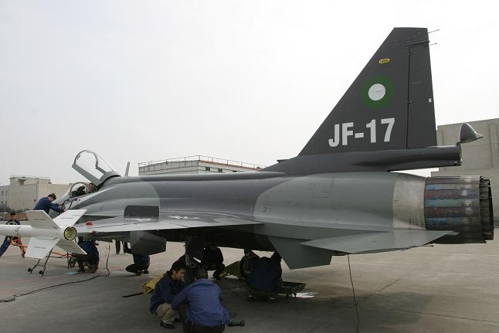
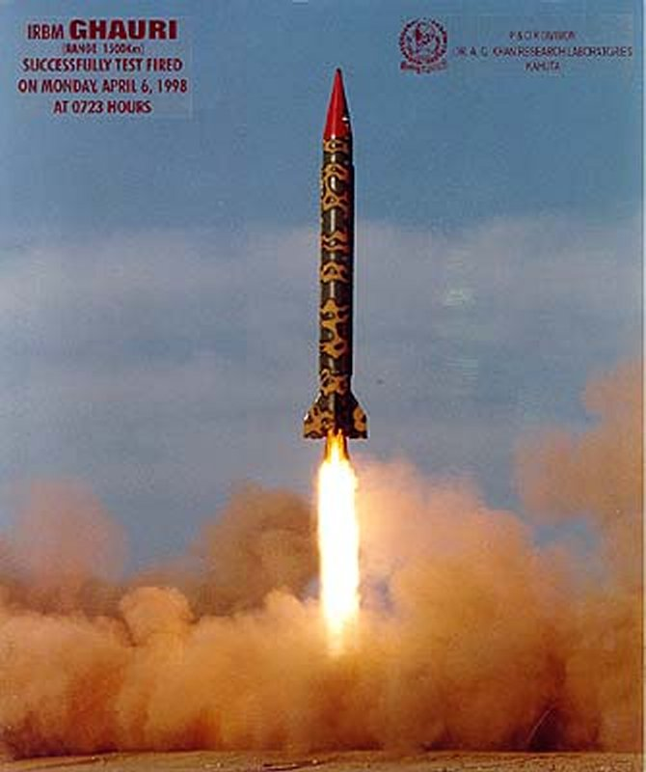
Where can we find software?

Slide 17
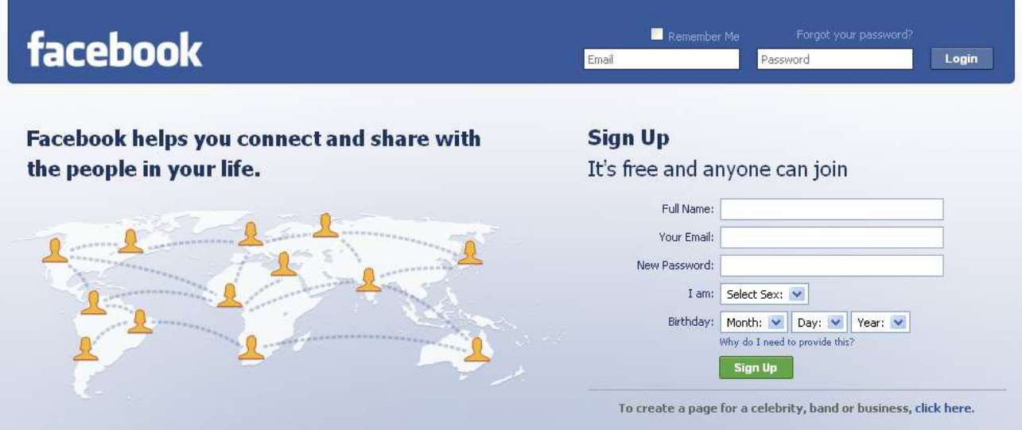
Some popular ones…

Slide 18
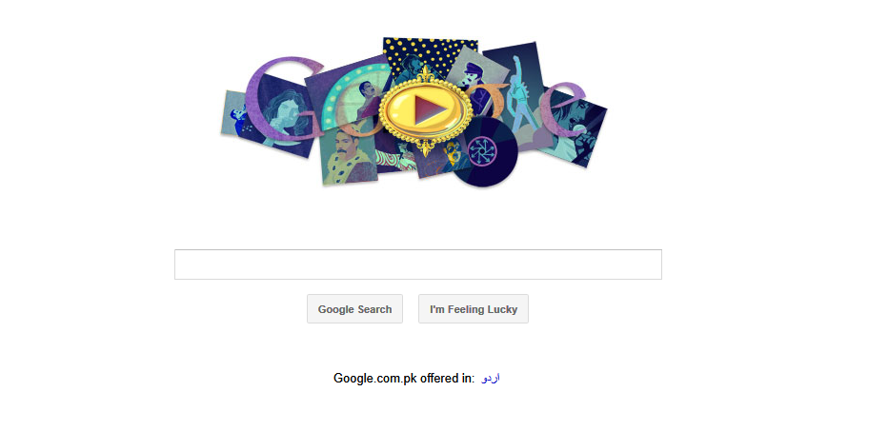
Some popular ones…

Slide 19
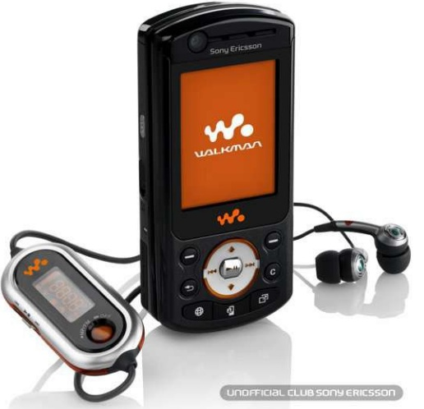
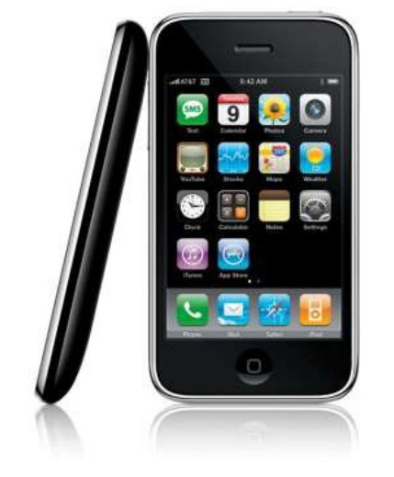
And even in…

Slide 20
Conclusion
Software is almost everywhere!

Slide 21
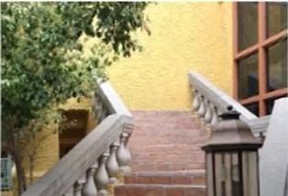
Why study Software Engineering Famous software bugs
A staircase that lead right into a wall

Slide 22
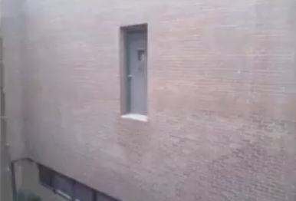
Why study Software Engineering Famous software bugs
A door that will drop you 10 feet down

Slide 23
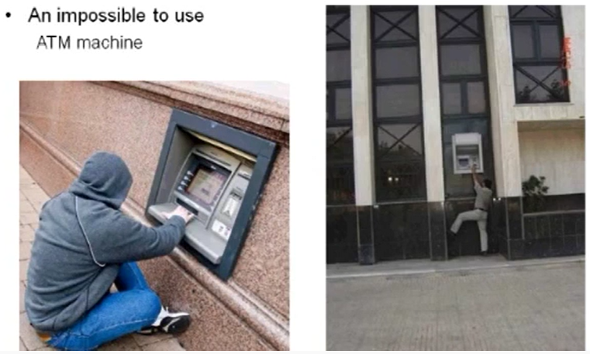
Why study Software Engineering Famous software bugs

Slide 24
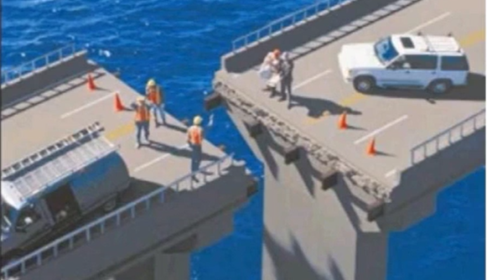
Why study Software Engineering Famous software bugs

Slide 25
Why study Software Engineering Famous software bugs
What do you thing is wrong with these real life scenarios
Requirements are correct
Staircase next to the outer wall
Door on the first floor
An ATM outside the bank branch
The bridge
The design is flawed

Slide 26
Problems in software development
Common issues
The final software does not fulfill the needs of the customer
Hard to extend and improve: if you want to add a functionality later its mission impossible
Bad documentation
Bad quality: frequent errors, hard to use, ...
More time and costs than expected

Slide 27
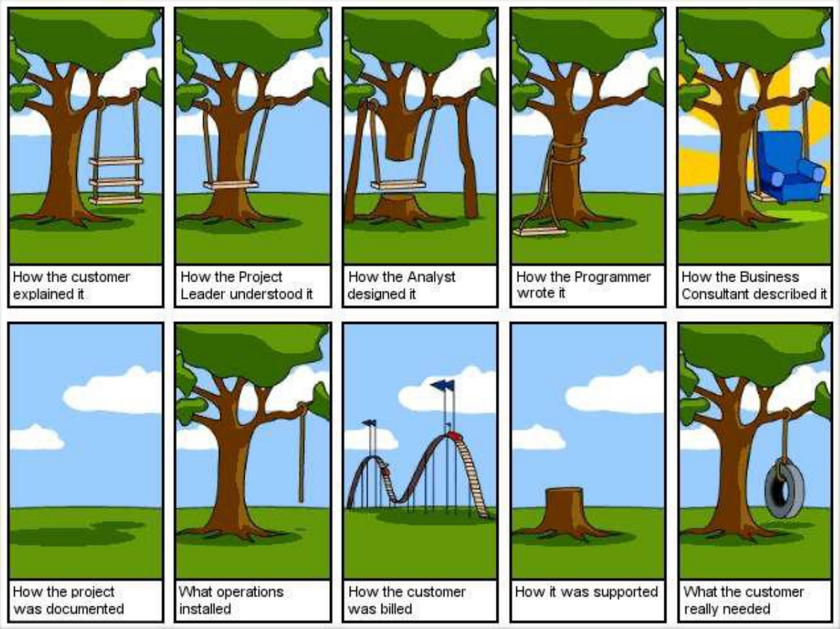
http://www.projectcartoon.com

Slide 28
Conclusion
Programming is NOT enough!
It is not enough to do your best: you must Know what to do, and THEN do your best. -- W. Edwards Deming

Slide 29
And Since…
A clever person solves a problem.
A wise person avoids it.
- Albert Einstein

Slide 30
Solution

Slide 31
▶ The application of a systematic,
▶ As defined in IEEE Standard 610.12:
disciplined, quantifiable approach to the development, operation, and maintenance of software; that is, the
application
software.
▶ Your opinion?
▶
of engineering to
What is Software Engineering?
This definition is descriptive, not
prescriptive
▶ It does not say how to do anything
▶ It just say what qualities S.E. should have
▶ As a result, many people understand
SE differently

Slide 32
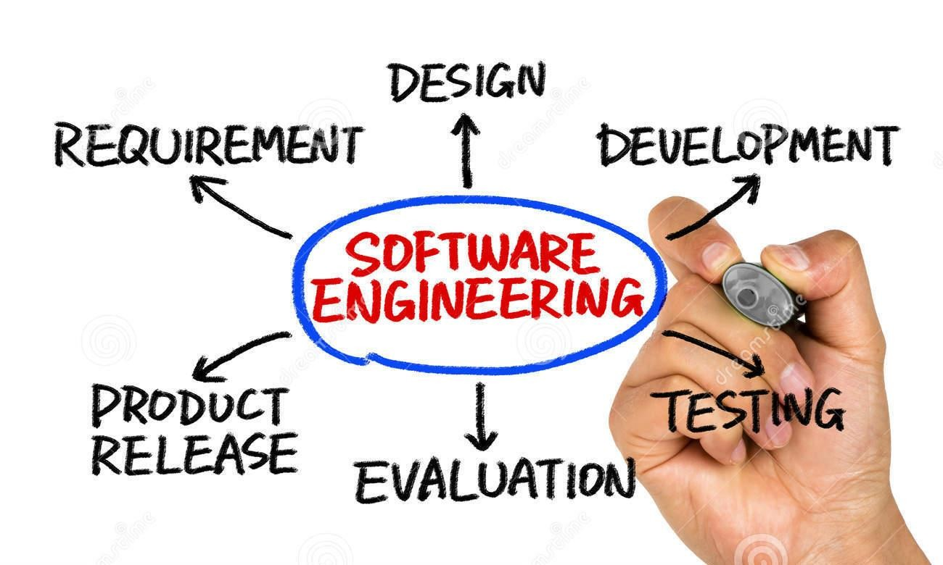
Software Engineering

Slide 33
Software Engineering
Objective is to produce software that is:
On time: is deliver at the established date.
Reliable: does not crash.
Complete: good documentation, fulfill customer needs.

Slide 34


